Slide 1

SaltStack for Multi-OS Security Hardening, PCI-DSS Compliance, and Reporting
Notes:
Insert logos, topic title, fix or remove copyright notice ?

Slide 2
What I hope you’ll get out of this?
Overview of PCI-DSS and formal hardening options
Why Salt is ideal for automating hardening and auditing
Problems you may will run into with Salt & multi-OS
What the ideal solution with Salt (probably) looks like

Slide 3
Customer Scenario
Small’ish start-up business, ~100 staff
~8 years of deferred (read: zero) security spending
Operating:
Customer facing infrastructure on AWS
Corporate infrastructure looked like a co-working site
Needed PCI-DSS compliance as a Level 1 Service Provider
Want to also get some security benefit beyond a box tick
Notes:
Brief overview of PCI-DSS requirements and how they lead to the requirement for a formal hardening methodology

Slide 4
PCI-DSS
Compliance regime enforced by VISA/MasterCard/AMEX/etc
Not that hard to achieve
Mostly about process
Usually tells you to go elsewhere for explicit technical requirements, e.g. industry accepted hardening guidelines…
Requirement #2.2 – “Develop configuration standards for all system components. Assure that these standards address all known security vulnerabilities and are consistent with industry-accepted system hardening standards. Sources of industry-accepted system hardening standards may include, but are not limited to: CIS/ISO/SANS/NIST”
Testing Procedure #2.2a – “Examine the organisation’s configuration standards for all types of system components and verify the system configuration standards are consistent with industry-accepted hardening standards.”
Notes:
Brief overview of PCI-DSS requirements and how they lead to the requirement for a formal hardening methodology

Slide 5
What is hardening not?
NOT – just a set of commands you run
NOT – a couple of config file changes
NOT – just done by software you pay lots of money for
NOT – a script you find on StackOverflow and run
NOT – just a Salt formula you find on GitHub and use

Slide 6
What is hardening?
It is the implementation of security controls designed to reduce risk to organisational assets.

Slide 7
Controls…
PCI-DSS – 12 requirements in 5 groups,
Requirement 2 – Do not use vendor-supplied defaults for system passwords and other security parameters.
Translation: Don’t trust the vendor to know what’s secure.

Slide 8
Formal Hardening Options
 | SANS SCORE Checklists | ISO 27K | NIST National Checklist Program | CIS Controls/Benchmarks | DISA STIG
Maintained | NO | Technically yes… | YES | YES | YES
Maintained By | Nobody… | Standards body | Vendors/Community | Non-profit org | US Military
Technical | YES | NO | YES | YES, highly | YES, highly
Windows | NO | Wot? | YES + refer CIS PDF’s | YES, all versions | YES, all versions
RedHat/CentOS | Kinda… <=EL5/2016 | Wot? | Refers to CIS free PDF | YES, all versions | YES, EL 6 + 7
Debian/Ubuntu | Kinda… generic info | Wot? | Refers to CIS free PDF | YES, <= 9 + <= 18.04 | Ubuntu only 16.04 LTS
MacOS (OS X) | Kinda… 2008 | Wot? | Kinda… <= 10.10 | YES, <= 10.13 | YES, <= 10.12
Others | Kinda… old/generic | Wot? | YES, but age varies | YES, many recent | YES, many recent
Formats | PDF | PDF$ | Variable, PDF, DOC, some SCAP | PDF, DOCX, XLS, SCAP | PDF, SCAP
Free | YES | NO | YES | YES (PDF / limited tools) | YES

Slide 9
Center for Internet Security (CIS)
Non-profit org created to promote and sustain best practice solutions for cyber defence
Provides benchmarks based on controls
Benchmarks are well documented and highly technical
They tell you what to do, why it should be done, and how to fix it
PDF versions are free
There’s a free tool “CIS-CAT Lite”
Subscription/Membership provides other formats and better tools
Notes:
Brief overview of CIS organisation and how they do/implement hardening

Slide 10
Hardening Process
It’s a lifecycle not a one-off event.
D
EFINE
Define the SOE and how auditing and remediation will occur.
Define
Audit
A
UDIT
Check operational systems for compliance with requirements.
R
Remediate
EMEDIATE
Apply fixes and updates; which need to be included in SOE and tools used for audit and remediation in future.
Notes:
Replace with circul flow graphs…

Slide 11
Tools & Methods
Windows
Windows LGPO/ADGPO
SMS/SCCM/Intune
CIS-CAT Pro
Rapid7 Nexpose
ThreatGuard S-CAT
Tenable SC5
Meraki MDM
IBM BigFix Compliance
Qualys SCAP Auditor
SAINT Security Suite 8
Tripwire Enterprise 8
SaltStack formulas/states
Linux
Satellite / Spacewalk
OpenSCAP
SMS/SCCM/Intune
Lynis
CIS-CAT Pro
Rapid7 Nexpose
ThreatGuard S-CAT
Tenable SC5
IBM BigFix Compliance
Qualys SCAP Auditor
SAINT Security Suite 8
Tripwire Enterprise 8
SaltStack formulas/states
MacOS
Lynis
Jamf / custom .pkg’s
Munki/etc / custom .pkg’s
SMS/SCCM/Intune/Parallels
Meraki MDM
CIS-CAT Pro
SaltStack formulas/states
Notes:
Most of the available tools meet

Slide 12
What’s SCAP ?
== Security Content Automation Protocol
Umbrella term for a series of related specifications from NIST
Asset Identification
Asset Reporting Format (ARF)
Common Platform Enumeration (CPE)
Open Vulnerability Assessment Language (OVAL)
Extensible Configuration Checklist Description Format (XCCDF)
Open Checklist Interactive Language (OCIL)
Trust Model for Security Automation Data (TMSAD)
Software Identification (SWID)

Slide 13
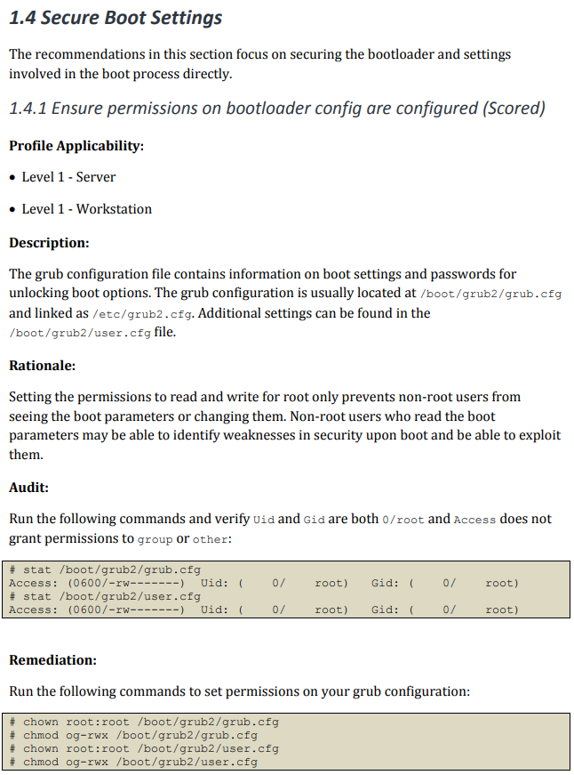
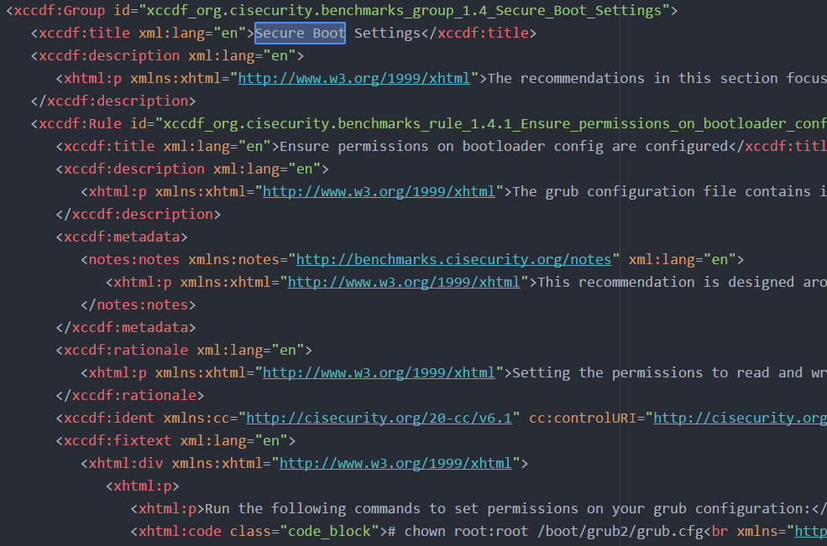
CIS Benchmarks
Notes:
Brief overview of CIS organisation and how they do/implement hardening

Slide 14
SCAP TL;DR
XML
Defines how to audit something
OVAL and/or XCCDF formats define this
Defines how to remediate something
XCCDF formats define this
Standard reporting/output formats, e.g. ARF
Every implementation for SCAP handling is unique at this point (in part due to versioning)

Slide 15
SCAP TL;DR
SCAP 1.0 ~ 2010
SCAP 1.1 ~ 2011
SCAP 1.2 ~ 2011
SCAP 1.3 ~ 2018

Slide 16
Hardening Process
Multi-OS
Must be machine readable
Must not require exceptional knowledge, time or effort to obtain/develop and utilise
It’s a lifecycle not a one-off event.
Multi O/S
Must utilise machine readable definitions
Must produce human readable and machine readable formats
Define
Audit
Remediate
Multi-OS
Automation capable
Event driven
Notes:
Replace with circul flow graphs…

Slide 17
Hardening Process
It’s a lifecycle not a one-off event.
Standard Operating Environment (SOE)
SCAP (XCCDF/OVAL)
SaltStack
Define
Audit
CIS-CAT Pro
SMS/SCCM/Intune
SaltStack
Remediate
SaltStack
Notes:
Replace with circul flow graphs…

Slide 18
Picking Salt
Really does work well (enough) across Win/Mac/Linux
Provides automation for hardening & remediation
Provides investigation and remediation capability
Event driven in order to drive automation of security lifecycle
Notes:
Brief discussion of how O/S can occur in various ways for different O/S types

Slide 19
Hardening with SaltStack…
SOE
Can support SOE build and deployment infrastructure
Can define what should happen to a system post-deployment
Can be used to help build hardened O/S images
Machine Readable Formats
Can’t immediately consume SCAP; but Salt is built on Python…

Slide 20
Hardening with SaltStack…
Post-Deploy State Auditing & Remediation
Install tools and run them – states/formulas/etc
Perform auditing – states/formulas/run tools/etc
Perform remediation – states/formulas/run tools/etc

Slide 21
Hardening with SaltStack…
Compliance & Auditing
Ensure audit data/reports get to appropriate storage
Support rapid ad-hoc collection of evidence
Support store and forward evidence collection
Auditing & Remediation Tool Updates
Deploy/update tools and run them, states/formulas/etc

Slide 22
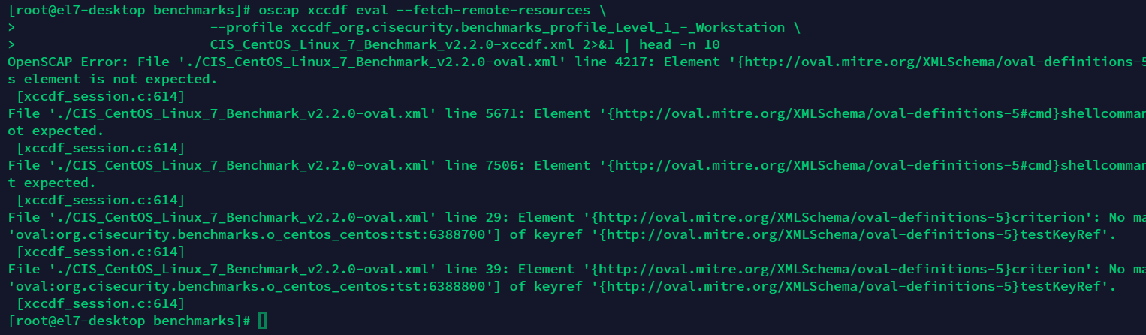
OpenSCAP rabbit hole…
https://www.open-scap.org/
Salt module: openscap.xccdf
Uses OpenSCAP `oscap xccdf eval` command
Works with SSG XCCDF… but doesn’t like CIS XCCDF/OVAL content…
Also… Linux only.
Notes:
Description of how Salty CIS-CAT works

Slide 23
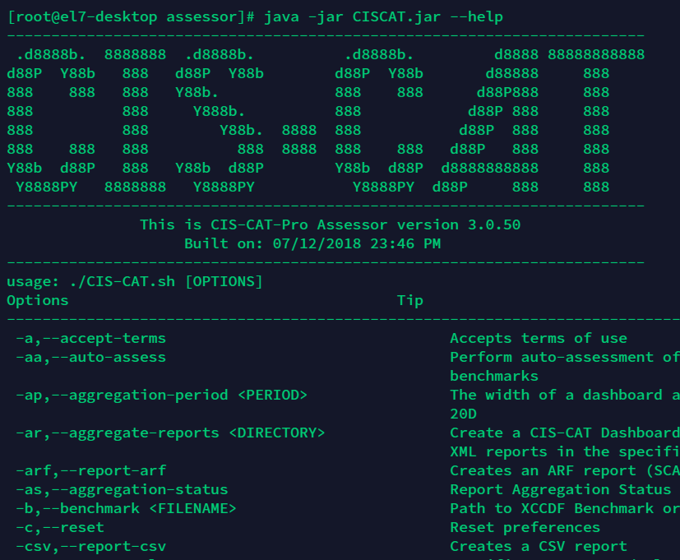
CIS-CAT Pro
Java (*sigh*)
Can output report results as:
ARF
HTML
CSV
OVAL
XML
Send XML report to CIS-CAT Dashboard
No doco for MacOS but works fine after you get JDK on there
Notes:
Brief overview of CIS organisation and how they do/implement hardening

Slide 24
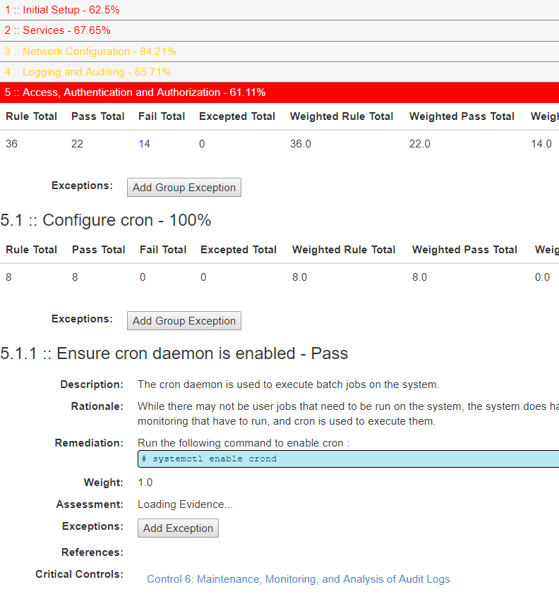
CIS-CAT Dashboard
.war for Tomcat 8+
Uses SQL DB for storage
LDAP for AAA
Uses bootstrap for webUI but still looks not great
Uses as much memory/CPU as you would expect from a Java webapp
Has a REST API ( doco may or may not exist )
Notes:
Brief overview of CIS organisation and how they do/implement hardening

Slide 25
Java Gotcha
Linux Minions
EL7’s official packaging is for Tomcat 7. There’s no good RPM’s for Tomcat 8 available.
MacOS
Hard to install
JRE is not JDK
You will want to use JDK on MacOS
Windows
salt-winrepo-ng doesn’t have JRE/JDK 10, 8 is the latest in there.
Notes:
Brief overview of CIS organisation and how they do/implement hardening

Slide 26
CIS-CAT Dashboard Cons
Have to deal with SQL database clustering, e.g. multi-master, replication, avoiding corruption etc
Can have HTTP/HTTPS terminate directly on Apache Tomcat… but it’s a bad idea… e.g. Java keystores must be used for HTTPS etc
You’ll want a web server, ideally with caching and load balancing capabilities in front of the damn thing/s, even in small internal-only deployments
Doesn’t actively do anything, e.g. it’s just there waiting… eating lots of memory, for systems to run tasks that will send benchmark audit reports in. It cannot be used to rapidly obtain evidence to place in front of an auditor or to investigate a security event.
Notes:
Brief overview of CIS organisation and how they do/implement hardening

Slide 27
CIS’ Recommended “Automation” for CIS-CAT Pro/Dashboard
Create API user and API token/s for use by CIS-CAT Pro installs to send reports to Dashboard
Linux/MacOS == bash script + cron
Windows == .bat script on network share + scheduled task locally defined or via AD Group Policy
Notes:
Brief discussion of why CIS org’s CIS-CAT Pro tool sucks and why to avoid it. TL;DR – Java on endpoints. Java central server. Lack of centralised management/control.

Slide 28
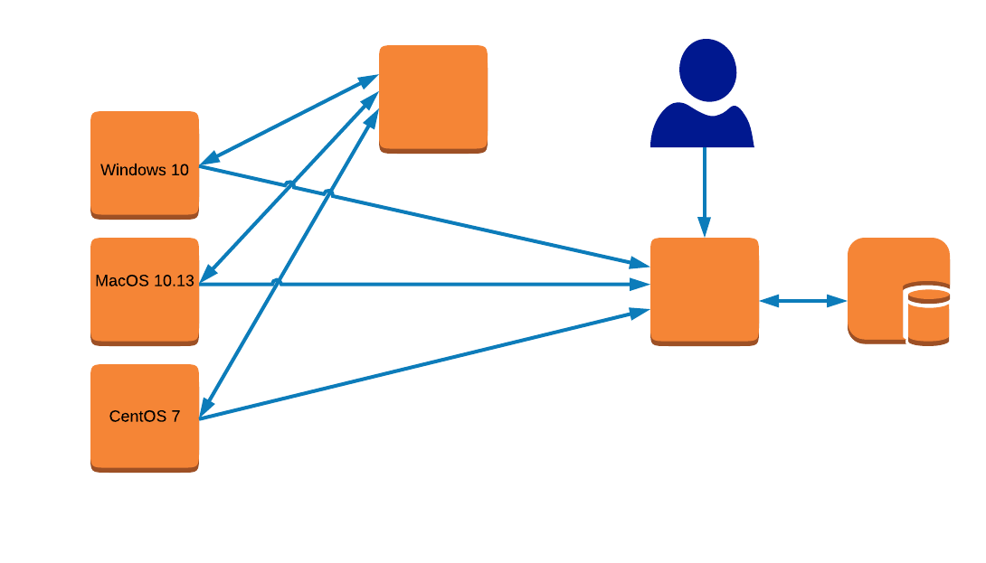
CIS-CAT/Dashboard Architecture

Slide 29
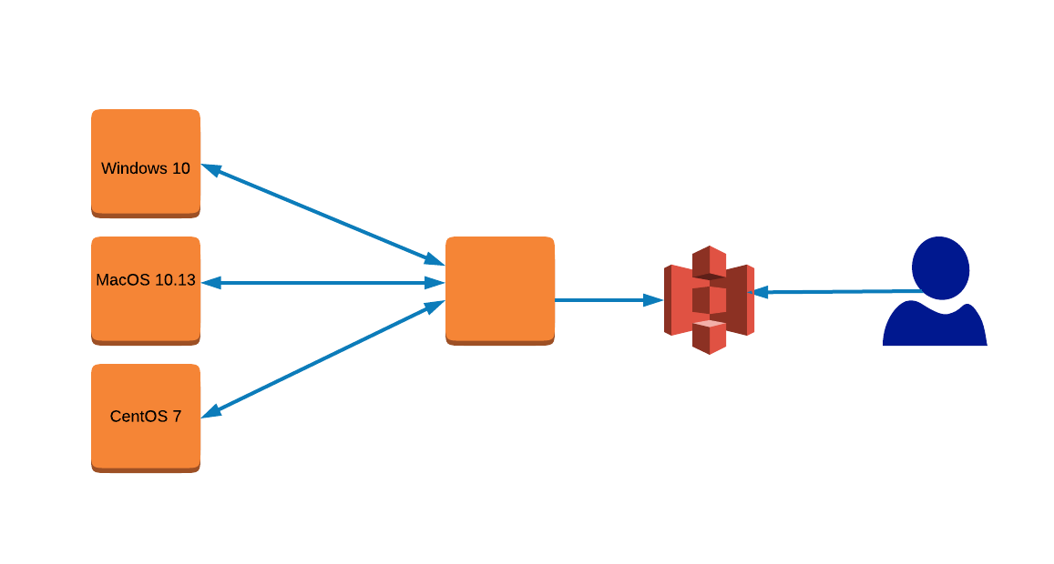
Salty CIS-CAT
Notes:
Description of how Salty CIS-CAT works

Slide 30
Salty CIS-CAT
SOE’s for Win/Mac/Linux defined inc Salt Minion & Java
Minion ensures latest CIS-CAT Pro + benchmark XCCDF/etcs installed
Minion performs hardening for Linux & MacOS systems (states)
ADGPO’s used from Active Directory on Windows systems
Salt logs go to ElasticSearch based log storage
AD logs go to ElasticSearch based log storage
CIS-CAT report runs are scheduled by state applied to minion
Pillar/grains select appropriate CIS-CAT level, benchmark and profile
Files sent to master using cp.push from minion
Master states scheduled to check for new files and push them to S3
Notes:
Description of how Salty CIS-CAT works

Slide 31
Salty CIS-CAT
generate_cis-cat_report:
cmd.run:
- name: 'java -jar CISCAT.jar {{ cis-cat_args }}’
- require:
- file: cis-cat-full
send_cis-cat_report:
cp.push:
- name: {{ report_destination }}
- remove_source: True
cis_evidence:
schedule.present:
- function: state.apply
- jog_args:
- cis.evidence
- when: {{ cis_settings.evidence.schedule }}
- require:
- file: cis-cat-full
{% for iteration %}
S3-send-{{ filename }}:
module.run:
- s3_custom.put:
- name: {{ bucket }}
- local_file: {{ filename }}
{% endfor %}
Notes:
Description of how Salty CIS-CAT works

Slide 32
Salty CIS-CAT Net Result
Hardened SOE’s deployed
SOE’d systems Salt Minion’ised
Daily hardening audit on each system
Auto-remediation for Linux/MacOS ( sensible sub-set of CIS items )
AD GPO fixes Windows issues
HTML reports stored in S3 bucket ( YES secured ☺ )
S3 does RBAC to reports
S3 does auto-archiving and removal
Notes:
Description of how Salty CIS-CAT works

Slide 33
Salty CIS-CAT Gotchas / Lessons
file.recurse with “clean” option (default) is horrible
CIS HTML/ARF reports can get BIG; e.g. 10+MB
Salt Mine is designed for **SMALL** pieces of information
file.read exec module chokes on large files
Salt Minion’s on Windows and MacOS will, by default, be missing important Python modules such as m2crypto, and can be hard to install quickly, e.g. MacOS needs Xcode tools
(Good) Endpoint Security Software often does not like SaltStack Minion OR CIS-CAT Assessor
Don’t use Salt Py3 packages, will break s3 module
Notes:
Description of how Salty CIS-CAT works

Slide 34
Salt CIS Formula
https://github.com/colin-stubbs/salt-formula-cis
Deploy and run CIS-CAT on Linux/MacOS/Windows
Deploy and run OpenSCAP on Linux
Deploy CIS Dashboard on Linux
Schedule CIS-CAT runs; gen reports in HTML/ARF/etc
Send reports to CIS Dashboard, Salt Master AND/OR S3 Bucket
Notes:
Description of how Salty CIS-CAT works

Slide 35
Salt CIS Formula
https://github.com/colin-stubbs/salt-formula-cis
cis.audit
cis.audit.schedule
cis.audit.schedule_remove
cis.cis_cat.assessor
cis.cis_cat.dashboard
cis.cis_cat.java
cis.cis_cat.remove_assessor
cis.cis_cat.remove_dashboard
cis.cis_cat.audit
cis.openscap.oscap
cis.openscap.audit
Notes:
Description of how Salty CIS-CAT works

Slide 36
Hardening via Formulas
https://github.com/colin-stubbs/salt-formula-macos
https://github.com/colin-stubbs/salt-formula-selinux
https://github.com/colin-stubbs/salt-formula-sssd
https://github.com/colin-stubbs/salt-formula-at
https://github.com/colin-stubbs/salt-formula-cron
https://github.com/colin-stubbs/salt-formula-prelink
https://github.com/colin-stubbs/salt-formula-services
https://github.com/colin-stubbs/salt-formula-haveged
https://github.com/colin-stubbs/salt-formula-aide
https://github.com/colin-stubbs/salt-formula-yum
https://github.com/colin-stubbs/salt-formula-audit
Notes:
Description of how Salty CIS-CAT works

Slide 37
Salty CIS Multi-OS Ideal Solution
Salt SCAP module/s load SCAP content, e.g. all CIS/SSG/STIG
Salt SCAP module/s have audit and remediate functions
Salt SCAP module/s can filter to individual rules
Audit triggers events for each pass/fail
Remediation triggers events for each change
Audit optionally sends reports to reporting destination/s
Logs go where logs should go
Generate alerts as appropriate using both Salt & log handler/s
Notes:
Description of how Salty CIS-CAT works

Slide 38
Salty CIS – OVAL Processing
No existing OVAL modules for Python, but xmltodict works fine,
https://docs.python-guide.org/scenarios/xml/
https://pypi.org/project/xmltodict/
https://oval.mitre.org/language/about/overview.html
http://oval.mitre.org/documents/docs-06/an_introduction_to_the_oval_language.pdf
http://ovalproject.github.io/getting-started/faqs/
https://access.redhat.com/documentation/en-us/red_hat_enterprise_linux/6/html/security_guide/sect-scap_format-oval
Notes:
Description of how Salty CIS-CAT works

Slide 39
Salty CIS – XCCDF Processing
Existing XCCDF modules for Python, but xmltodict works fine too,
https://pypi.org/project/xccdf/
https://pypi.org/project/xccdfparser/
https://csrc.nist.gov/projects/security-content-automation-protocol/specifications/xccdf/
Notes:
Description of how Salty CIS-CAT works

Slide 40
Salty CIS – State Module
Not read yet. Sorry.
(Hopefully releasable during SaltConf18)
Notes:
Description of how Salty CIS-CAT works

Slide 41
Salty CIS-CAT Interim Hack
Salt execution module to deploy/run CIS-CAT Pro Assessor
Salt minion audits system using CIS-CAT
Use formulas for hardening; choose what to auto-remediate
CIS-CAT sends reports to CIS-CAT Dashboard OR Foreman with OpenSCAP Plugin
Reporting destination makes it easy for analysts and other authorised staff to access appropriate content in the most useful format for them (XML, HTML, CSV, whatever)
Logs go where logs should go
Log and/or report destination/s generate alerts as appropriate
Notes:
Description of how Salty CIS-CAT works

Slide 42
Salty CIS-CAT Execution Module
https://github.com/routedlogic/salt-formula-cis
Notes:
Description of how Salty CIS-CAT works

Slide 43
Foreman with OpenSCAP Plugin
Notes:
Description of how Salty CIS-CAT works

Slide 44
Foreman with OpenSCAP Plugin Architecture
Notes:
Description of how Salty CIS-CAT works

Slide 45
Foreman with OpenSCAP Plugin Demo
Notes:
Description of how Salty CIS-CAT works

Slide 46
Other Things You Should Consider
HubbleStack - https://github.com/hubblestack
What is?
Compliance framework
Originally built on Salt; now (mostly) independent of Salt
Auditing & Reporting – Specific Splunk/ELK integration
File Integrity Monitoring
Doesn’t do hardening
Doesn’t use SCAP DS/XCCDF/OVAL – update/translation process
No MacOS support
Notes:
Description of how Salty CIS-CAT works

Slide 47
Questions ?
Linkage
https://github.com/colin-stubbs
https://github.com/colin-stubbs/salt-formula-cis
https://equatetechnologies.com.au
https://cavalryscout.com

